Slide 1
PROJECT ON
MUSIC PLAYER
(USING HTML, CSS, JS)
INDUSTRIAL TRAINING REPORT
By Bhanu Pratap
01614813120
5ITE1

Slide 2
WEB DEVELOPMENT
Project Goal
Our product is a web based music player that allows users to listen to their music libraries using a server program on their home computer and a web based client to connect to that server and stream the music.

Slide 3
WEB DEVELOPMENT
Web development refers to the building, creating, and maintaining of websites. It includes aspects such as web design, web publishing, web programming, and database management. It is the creation of an application that works over the internet i.e. websites.
The word Web Development is made up of two words, that is:
Web: It refers to websites, web pages or anything that works over the internet.
Development: Building the application from scratch.

Slide 4
Web Development can be classified into two ways:
Frontend Development
Backend Development

Slide 5
FRONTEND WEB DEVELOPMENT
The part of a website that the user interacts directly is termed as front end. It is also referred to as the ‘client side’ of the application
consist of-
HTML
CSS
JAVASCRIPT

Slide 6
PROJECT MUSIC PLAYER
The project is a Music Player using Front-End Development. Project title is "MUSIC PLAYER". As the name suggest it is used to play music . It has a buttons like play/pause with the help of these buttons we can start/play the music. It is happening dynamically with the help of javascript .Without JavaScript it wasn’t possible.

Slide 7
IMPLEMENTATION
Languages Used
  HTML
  CSS
  JavaScript

Slide 8
THE PROJECT CONSISTS OF A NUMBER OF FILES:
Music.html
This file is the main and central file of the project. This file contains the HTML code and code to include other files as well. This file contains all the code which is practically visible to us on the site.
Music_styles.css - Contains the various css commands to beautify the Music HTML

Slide 9
Music_java.js
-Contains functional code for Music HTML file.
Cover-
-It contains the Images for background cover in jpeg format.
Songs
-It contain the audio file for the songs.

Slide 10
MUSIC PLAYER APP STRUCTURE:
It is divided into two parts –
1.Background body It basically contain the whole app.
2.Main Body . –
It contains the Song Name at top. –
Then there is Artist Name below the Song name. - Below Artist Name there is a background cover image for respective Artist. –

Slide 11
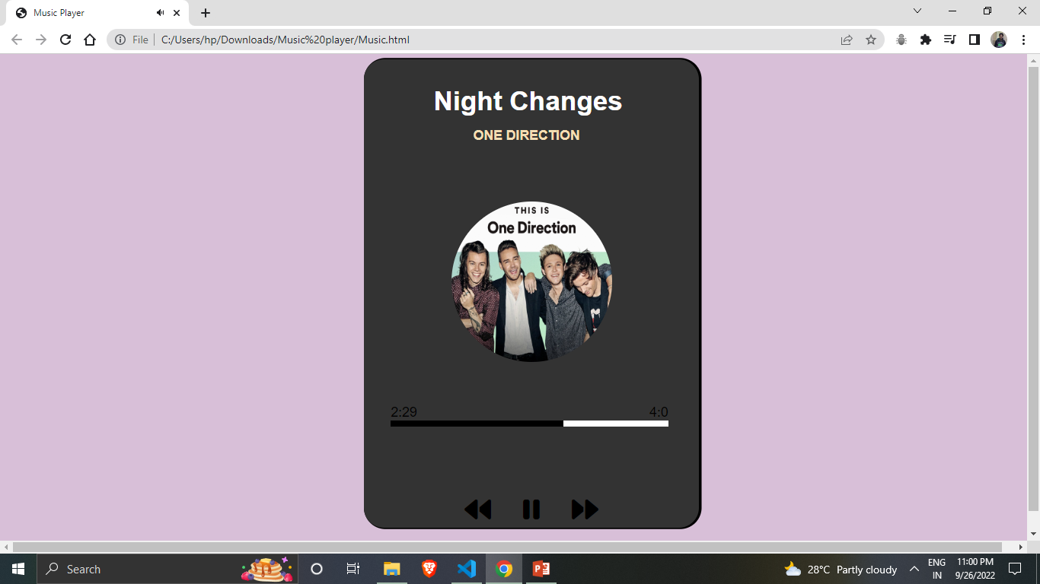

Slide 12
-Below Background cover image it contain the progress bar which tells about the progress of a song.
At bottom there is buttons for changing the music or to play/pause the music.
- Songs are getting changed because of javaScript.
Whenever we click on next/prev button the songs/song name/artist name/background img gets changed automatically

Slide 13
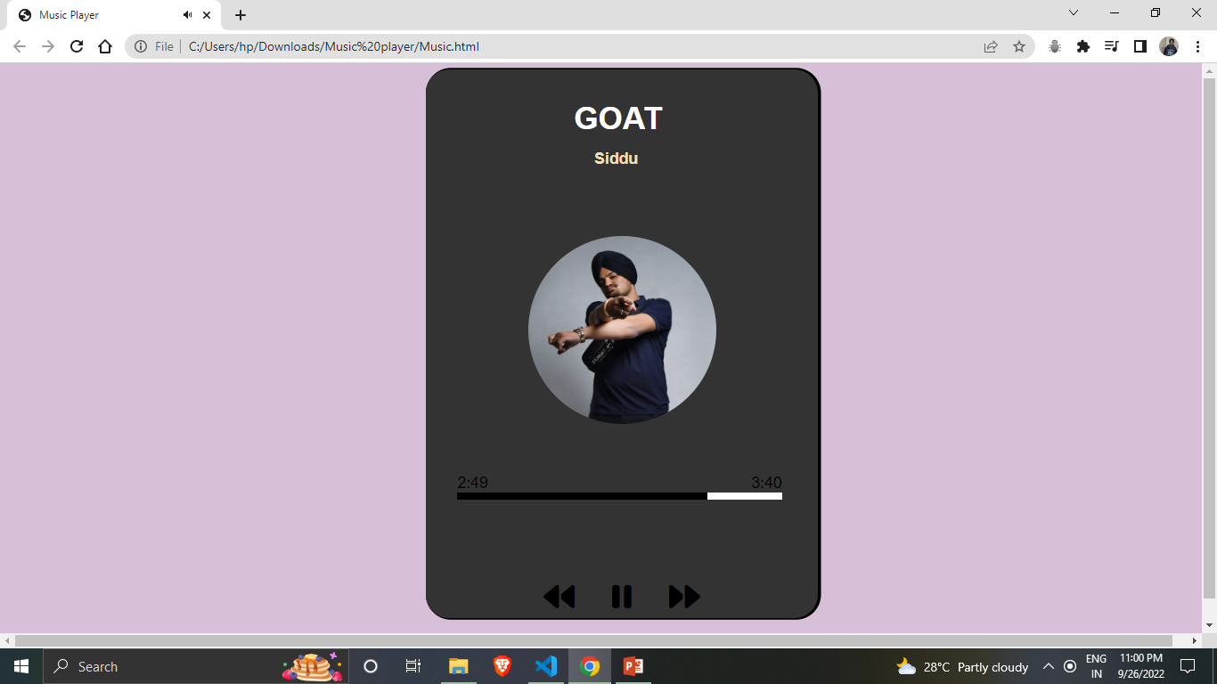

Slide 14
